Slide 1

Knowledge Sharing Session on HTML and CSS
Basic HTML and CSS
Ferdous Mahmud Shaon
February 2014

Slide 2
HTML, XHTML, HTML5

Slide 3
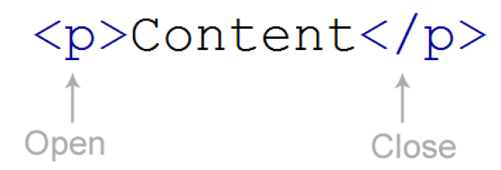
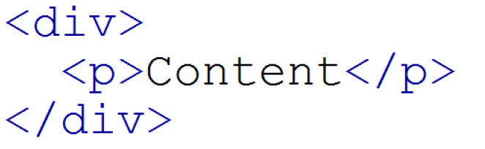
HTML Tags and Nested Tags

Slide 4
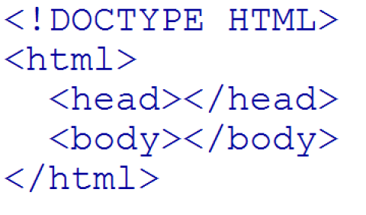
HTML Basic Structure

Slide 5
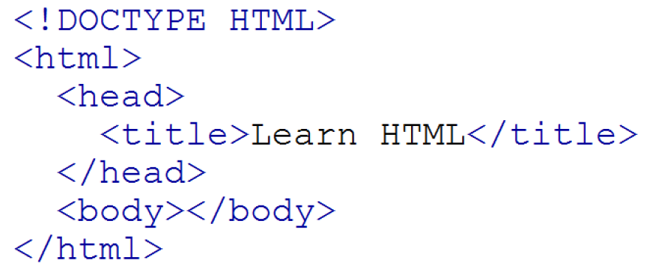
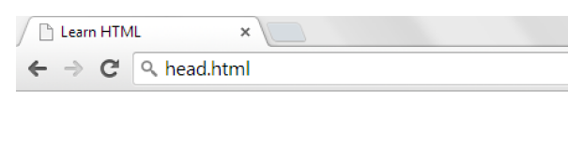
HTML <head> and <title>

Slide 6
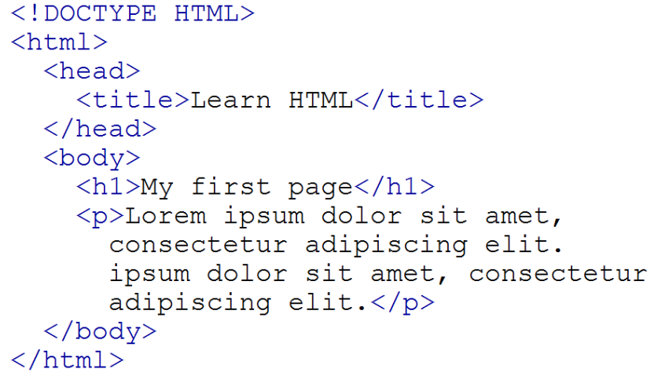
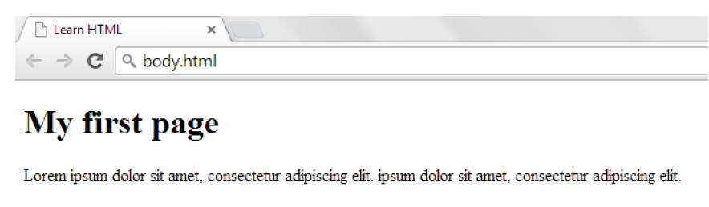
HTML <body>

Slide 7
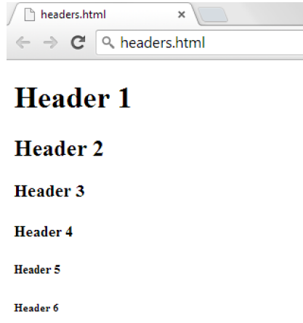
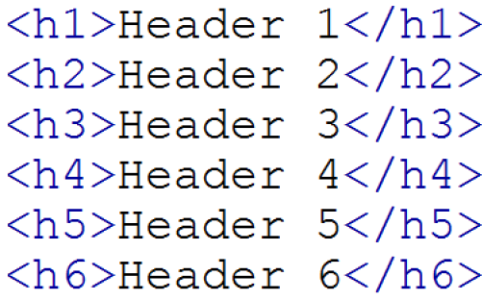
HTML Headlines

Slide 8
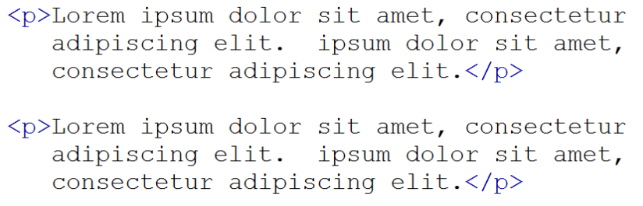
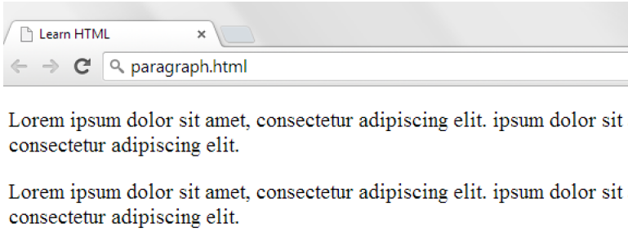
HTML Paragraphs

Slide 9
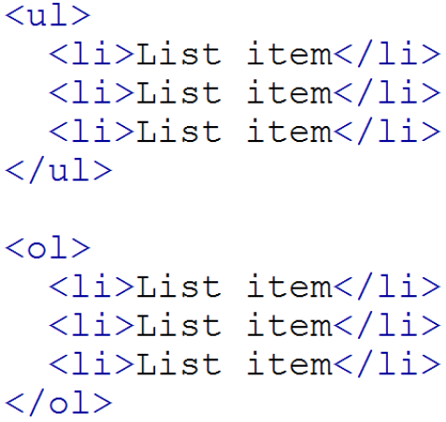
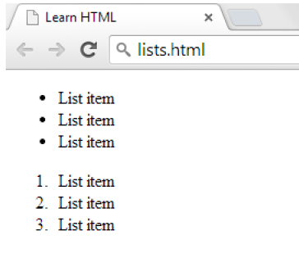
HTML Lists

Slide 10
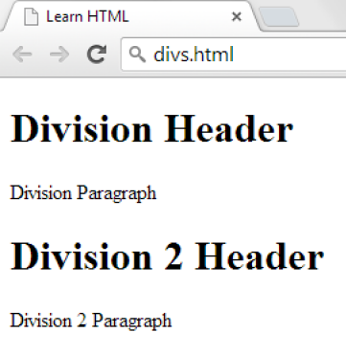
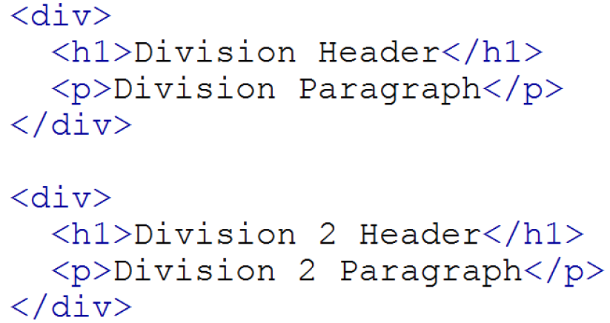
HTML Divisions (sections)

Slide 11
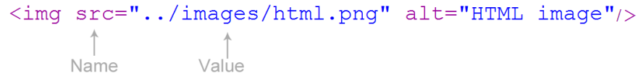
HTML Images

Slide 12
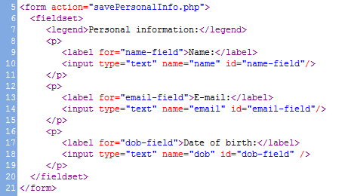
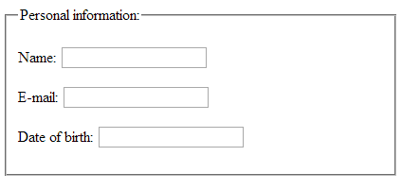
HTML form

Slide 13
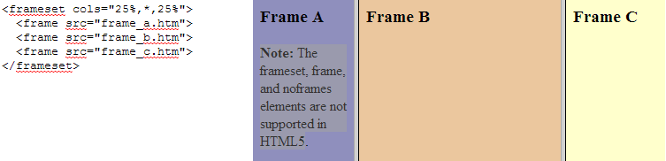
HTML frameset
Not recommended tag
Not supported in HTML5

Slide 14
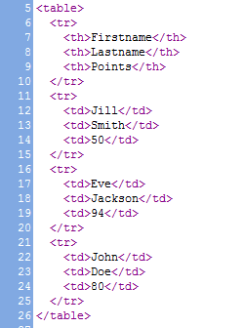
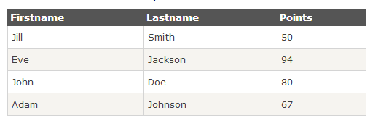
HTML tables

Slide 15
HTML Block vs Inline elements
Block Elements
Takes up the full width available, and has a line break before and after it.
<p>, <div>, <h1>…. <h6>, <ul>, <ol>, <li>, <table>
Inline Elements
Takes up only as much width as necessary, and does not force line breaks after it.
<a>, <span>, <img>

Slide 16
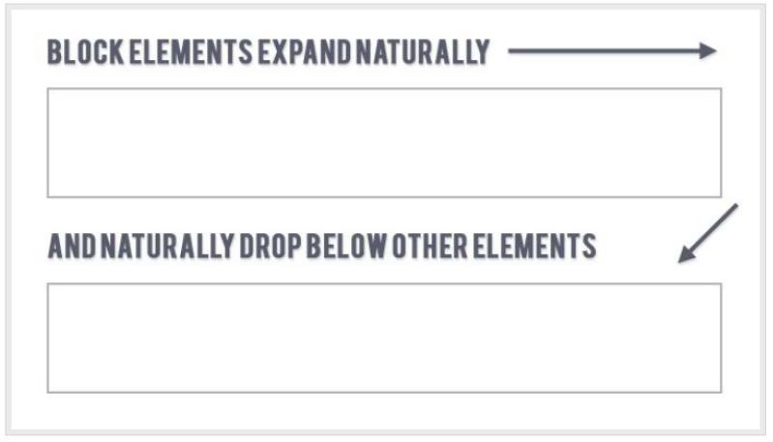
HTML Block elements

Slide 17
HTML Block Elements

Slide 18
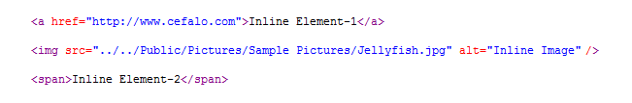
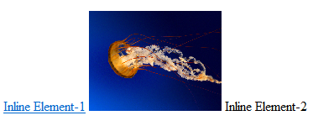
HTML Inline Elements

Slide 19
HTML Table vs DIV
Most websites have put their content in multiple columns.
Multiple columns can be created by using <div> or <table> elements.
Even though it is possible to create nice layouts with HTML tables, tables were designed for presenting tabular data - NOT as a layout tool!
The div element is used for grouping HTML elements and for creating rows and columns with the help of CSS.

Slide 20
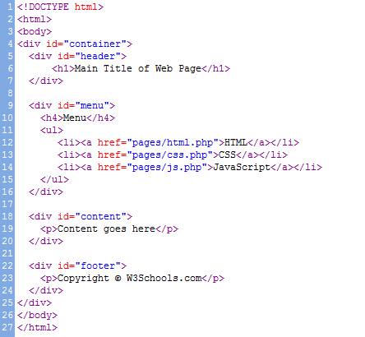
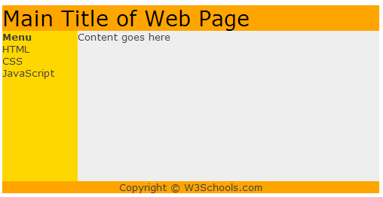
HTML Page Layout

Slide 21

HTML Layout

Slide 22
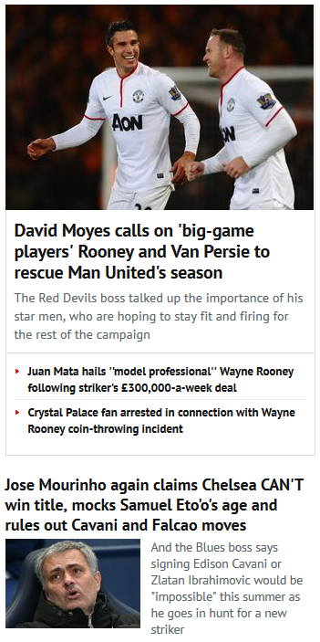
HTML Layout

Slide 23
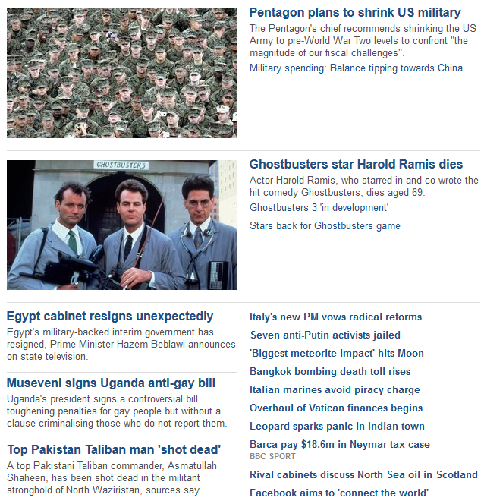
HTML Layout

Slide 24

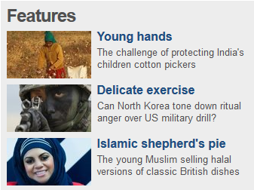
HTML Layout

Slide 25
HTML <!DOCTYPE>
Must be the very first thing in HTML document, even before the <html> tag
Provides information to the web browser about what version of HTML the page is written in.
In HTML 4, the <!DOCTYPE> declaration refers to a DTD, but in HTML5, the <!DOCTYPE> declaration does NOT refer to any DTD.

Slide 26
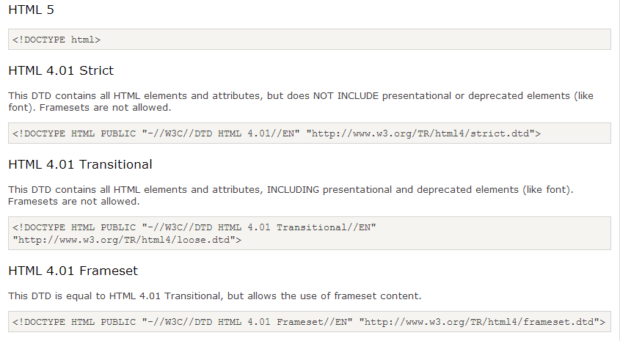
HTML <!DOCTYPE>

Slide 27
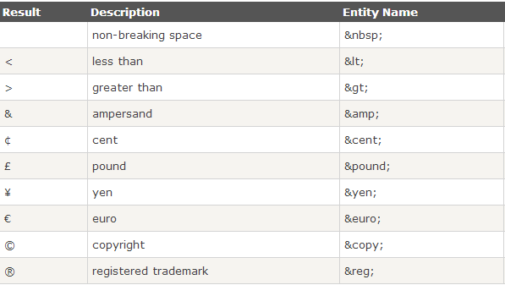
HTML Character Entities

Slide 28
HTML vs XHTML
XHTML
eXtensible HyperText Markup Language
Stricter and cleaner version of HTML similar to XML
Better cross browser support

Slide 29
HTML vs XHTML
XHTML DOCTYPE
mandatory
XHTML elements
must be properly nested
must always be closed
must be in lowercase
must have one root element
XHTML attributes
names must be in lower case
values must be quoted
minimization is forbidden
<input type="checkbox" checked="checked" />
<input disabled="disabled" />

Slide 30
SEO friendly HTML
Meaningful and relevant HTML <title> per page
Define <meta> description and keywords for each page. <meta name="description" content="Free Web tutorials on HTML and CSS"> <meta name="keywords" content="HTML, CSS, XML, XHTML, JavaScript">
Use an <h1> tag for the main headline of the page. It shouldn’t be more than one in a single page.
Relevant sub-headlines should use an <h2>…<h6> tags according to their priority.
Avoid embedded JS and CSS whenever possible. Try to use external CSS and JS and if possible minimize them.

Slide 31
New HTML5 Tags
<canvas> defines graphic drawing using JavaScript
<audio> defines sound or music content
<video> defines video or movie content
<header> defines a header for the document or a section
<nav> defines navigation links in the document

Slide 32
New HTML5 Tags
<section> defines a section in the document
<main> defines the main content of a document
<article> defines an article in the document
<footer> defines a footer for the document or a section
<figure> defines self-contained content, like illustrations, diagrams, photos etc.

Slide 33
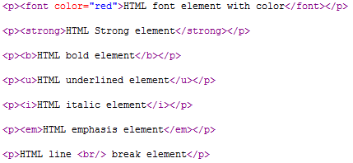
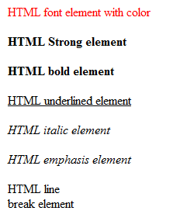
HTML Style Elements
<font>, <strong>, <b>, <u>, <i>, <em>, <center>

Slide 34
What is CSS?
Cascading Style Sheets
Defines how to display HTML elements
Added to HTML 4.0
Current version is CSS 2.
CSS 3 is also released and supported by most of the browsers.

Slide 35
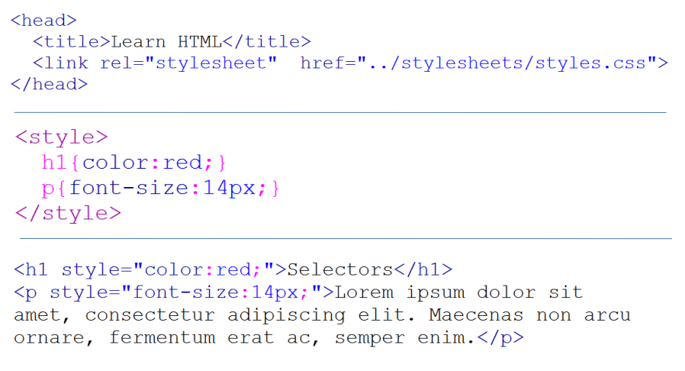
How to use CSS

Slide 36
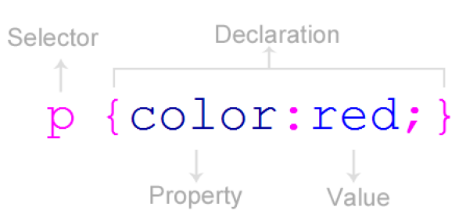
CSS Rules

Slide 37
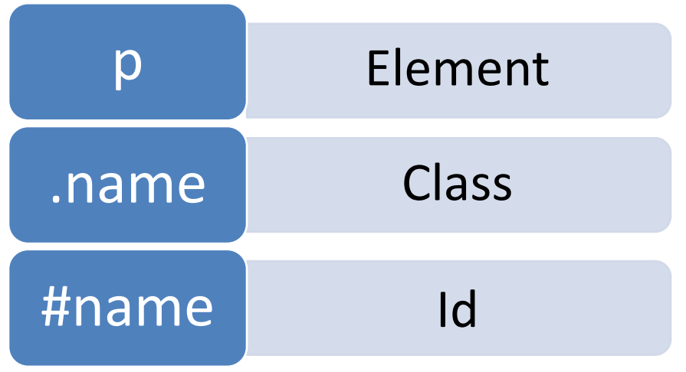
CSS Selectors

Slide 38
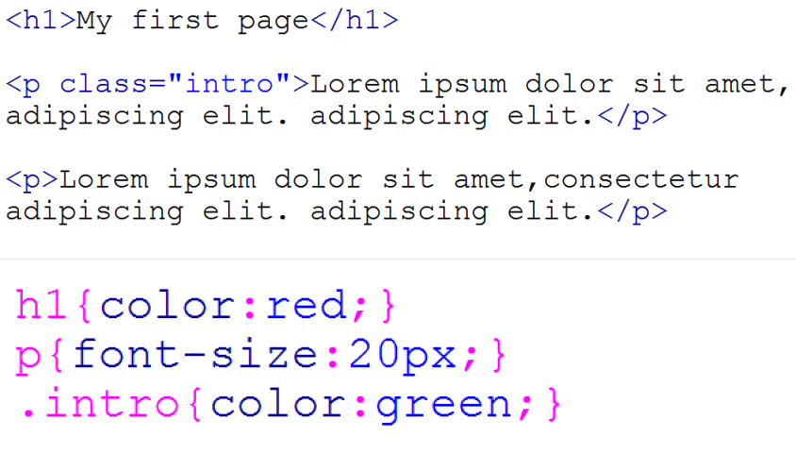
CSS Selectors

Slide 39
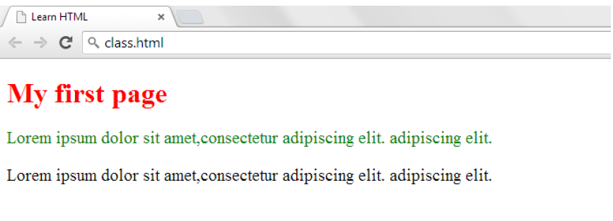
CSS Selectors

Slide 40
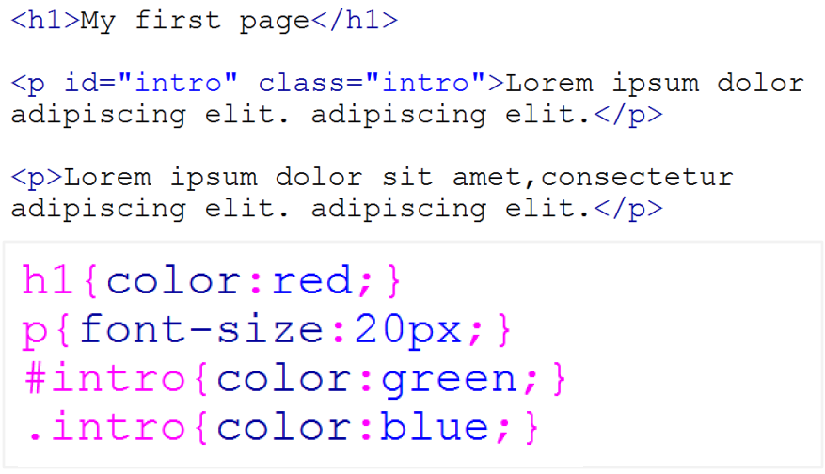
Multiple CSS Rules

Slide 41
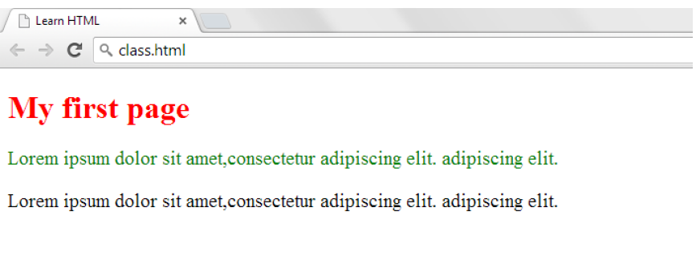
Multiple CSS Rules

Slide 42
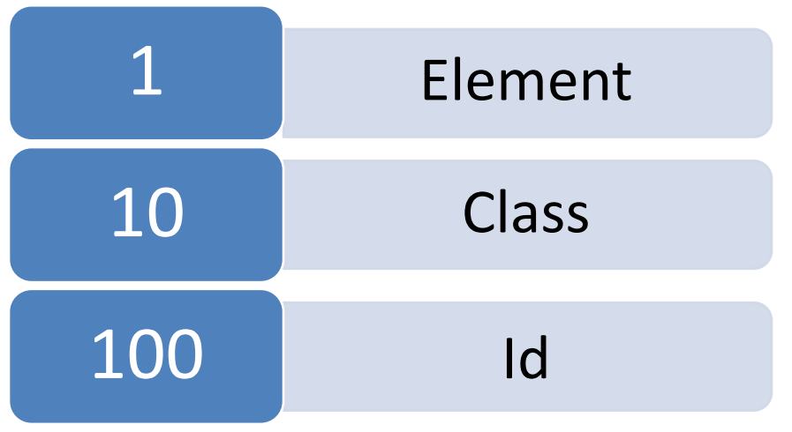
CSS Selector Priority

Slide 43
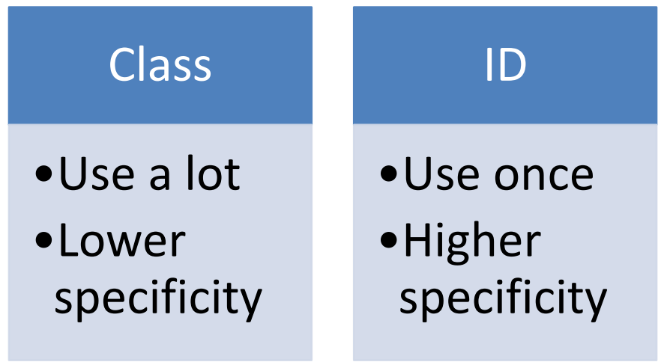
CSS class vs id selector

Slide 44
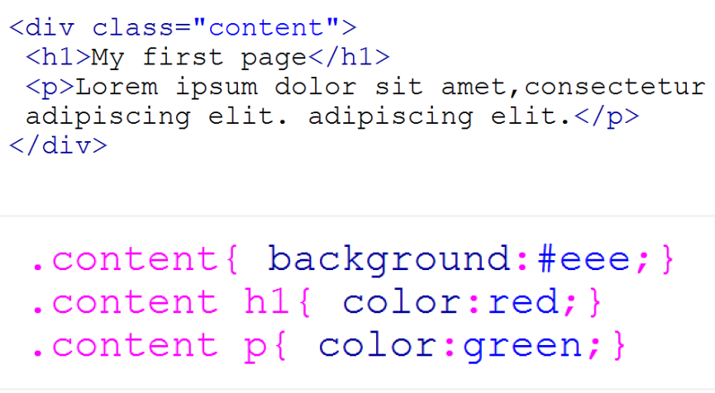
CSS Descendent Selector

Slide 45
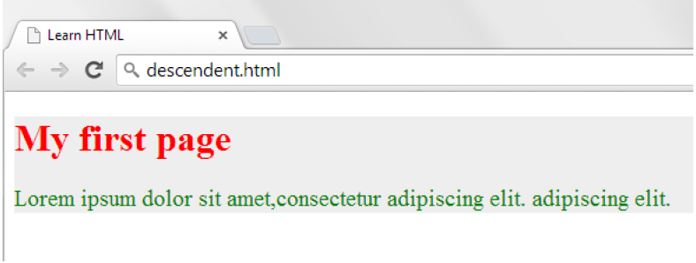
CSS Descendent Selector

Slide 46
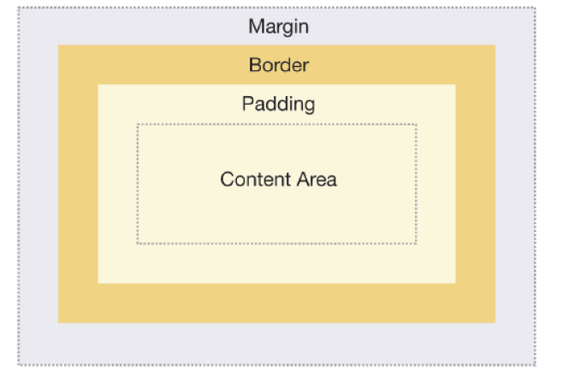
CSS Box Model (block element)

Slide 47
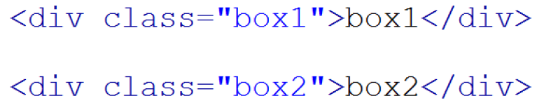
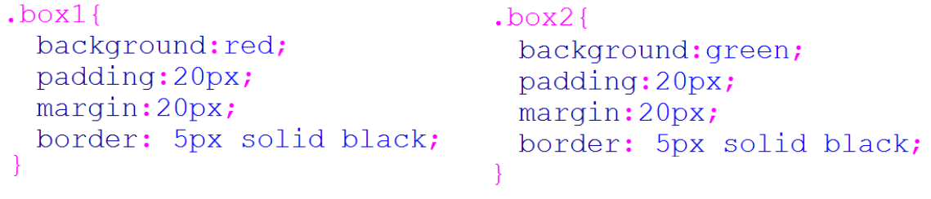
CSS Box Model (block element)

Slide 48
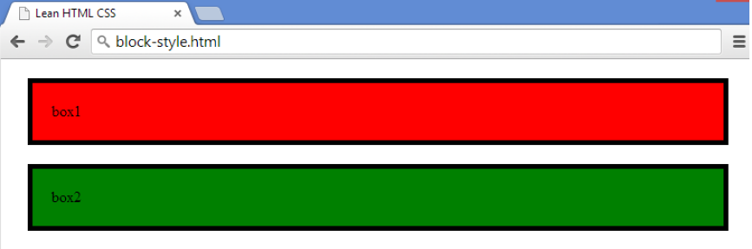
CSS Box Model (block element)

Slide 49
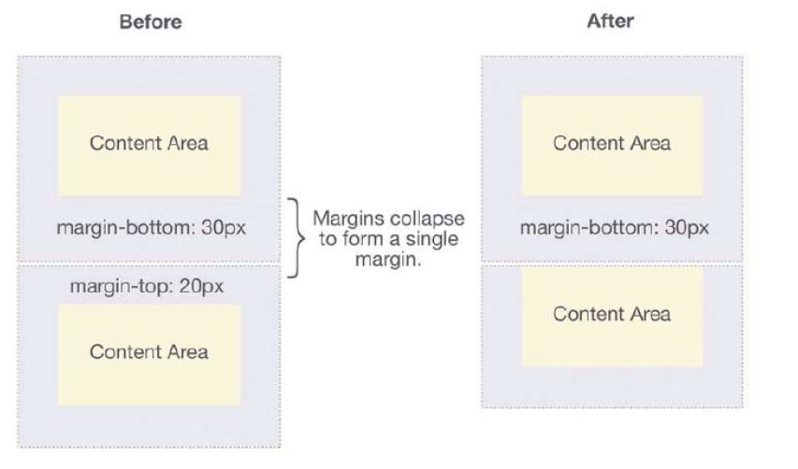
CSS Box Model – Margin Collapse

Slide 50
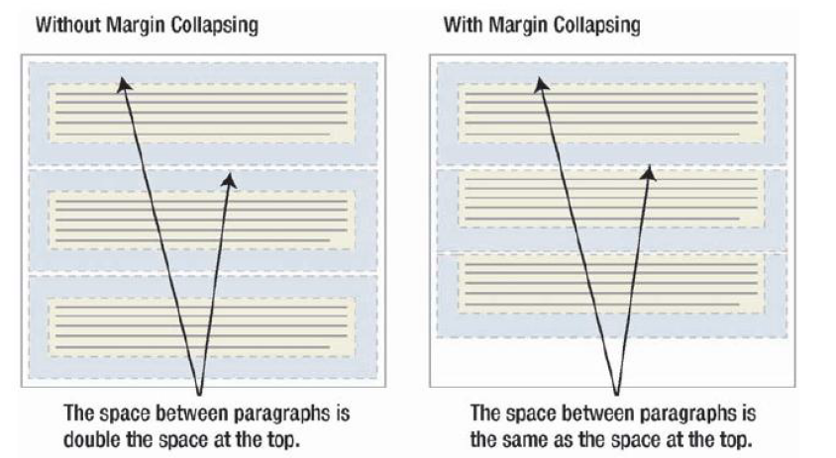
CSS Box Model – Margin Collapse

Slide 51



CSS Box Model – Margin Collapse

Slide 52


CSS Box Model – Margin Collapse

Slide 53


CSS Box Model – Margin Collapse

Slide 54

CSS Box Model (inline element)

Slide 55


CSS Box Model (inline element)

Slide 56

CSS Box Model Shortcuts

Slide 57


CSS Box Model Dimensions

Slide 58

CSS Box Model and Box Sizing
CSS3 Property
box-sizing: content-box; /* Default value */
box-sizing: border-box; /* Grid in Twitter Bootstrap */

Slide 59
CSS Dimension
height
Sets the height of an element
max-height
Sets the maximum height of an element
min-height
Sets the minimum height of an element
width
Sets the width of an element
max-width
Sets the maximum width of an element
min-width
Sets the minimum width of an element

Slide 60
Display and Visibility
Hiding an Element
display:none (doesn’t take space)
visibility:hidden (takes space)
Styling block / inline HTML Element
ul.menu li { display:inline; }
div.data span { display:block; }

Slide 61





Building Menu using HTML & CSS

Slide 62


Building Menu using HTML & CSS

Slide 63
CSS ‘position’ Property
static
default value
not affected by top, right, bottom, left
relative
positioned relative to its normal position
absolute
positioned relative to the nearest relatively positioned ancestor
if no relatively positioned ancestors, then it uses the document body
fixed
positioned relative to the viewport
always stays in the same place even if the page is scrolled.

Slide 64

CSS Relative Positioning

Slide 65

CSS Absolute Positioning

Slide 66



CSS Relative and Absolute Positioning

Slide 67

CSS Fixed Positioning

Slide 68

CSS Floating

Slide 69

CSS Floating Problem

Slide 70



CSS Floating Issues

Slide 71


CSS Floating Issues

Slide 72


CSS Floating Issues

Slide 73
Grouping and Nesting Selectors
Grouping Selectors
div, p, span { font-family: "Helvetica Neue", Arial, Helvetica; }
Nesting Selectors
#main .data p { color:blue; }
.widget.data p { color:blue; }
#main .data > p { color:blue; }

Slide 74
CSS Pseudo-classes Selectors
Syntax: selector:pseudo-class { property:value; }
Anchor Pseudo-classes
a:link {color:#FF0000;} /* unvisited link */
a:visited {color:#00FF00;} /* visited link */
a:hover {color:#FF00FF;} /* mouse over link */
a:active {color:#0000FF;} /* selected link */
First-child Pseudo-class
ul.menu > li:first-child { margin-left:0; }

Slide 75
CSS Opacity / Transparency
Transparency
opacity:0.5;
filter:alpha(opacity=50); /* For old IEs */
Cross browser Transparency
.transparent { /* IE 8 */
-ms-filter: "progid:DXImageTransform.Microsoft.Alpha(Opacity=50)"; filter: alpha(opacity=50); /* IE 5-7 */
-moz-opacity: 0.5; /* Netscape */ -khtml-opacity: 0.5; /* Safari 1.x */
opacity: 0.5; /* Good browsers */
}

Slide 76



CSS Image Sprites
An image sprite is a collection of images put into a single image.
Reduces load time and saves bandwidth.
img.home { width:46px; height:44px; background:url(img_navsprites.gif) 0 0; }
img.next { width:43px; height:44px; background:url(img_navsprites.gif) -91px 0; }

Slide 77
CSS Hacks - IE Detection and Conditional CSS
http://www.sitepoint.com/microsoft-drop-ie10-conditional-comments/
http://msdn.microsoft.com/en-us/library/ms537512%28VS.85%29.aspx
<!--[if IE]>
<p>You are using Internet Explorer >=5 and <= 9.</p>
<![endif]-->
<![if !IE]>
<p>You are using Internet Explorer >=10 or other browsers.</p>
<![endif]>
Using jQuery for jQuery < 1.9
if (jQuery.browser.msie && jQuery.browser.version < 8) {
// do something
}

Slide 78
CSS Hacks
IE7 doesn’t understand ‘display: inline-block’
display:block; float:left;
display: inline-block; *display: inline; zoom: 1;

Slide 79
CSS – major IE6 Problem
IE6 doesn't support multiple class selectors.
So when we write, div.menu.horizontal.widget { color: blue; } in IE6, the above style is interpreted as: div.widget { color: blue; }
This style definition affects all div elements having widget style class.

Slide 80
Thank You!

